Slide 1
Visualize GitHub Social Network
Asep Trisna Setiawan
23221111

Slide 2
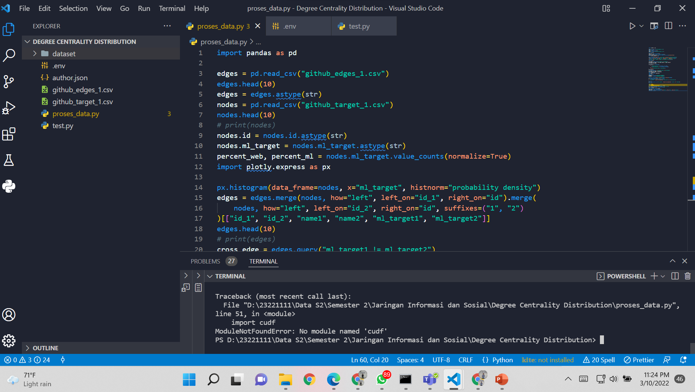

Slide 3
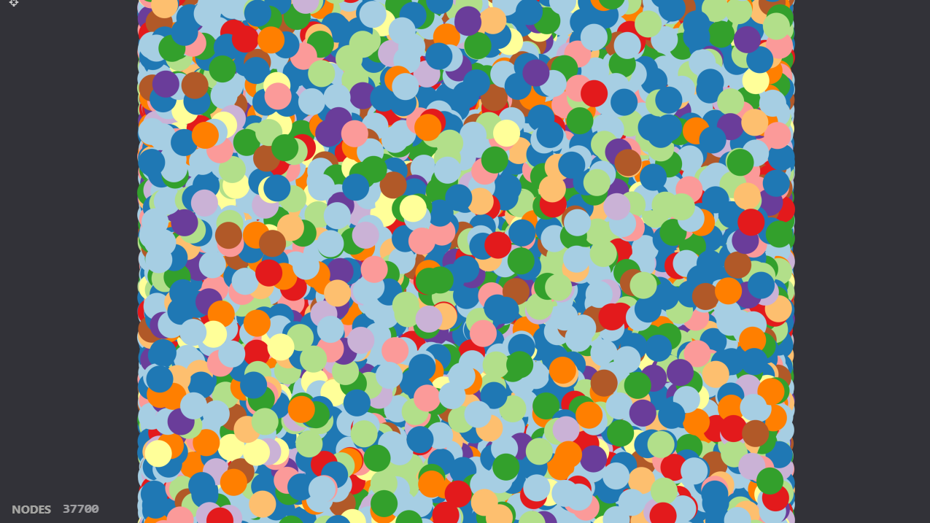

Slide 4
